Slide 1
MDO – Marketing Digital Outdoor
Analysis
Embedded Systems
Group 8:
José Pires | A50178
Hugo Freitas | A88258

Slide 2
Agenda
Recap
Problem statement
Project Goals
Analysis
Requirements & Constraints
System Overview
System Architecture
Subsystem decomposition
Budget estimation

Slide 3
1. Introduction

Slide 4
Problem Statement
The project consists of a marketing digital outdoor (MDO) with:
sound and video display, and fragrance emission selected by the brands,
providing a gesture-based interface for user interaction to create pictures and GIFs, brand-specific,
and share them on social media.

Slide 5
Project Goals
The key goals identified and the respective path to attain them are:
devise a device with audio and video outputs, as well as fragrance diffusion:
understand audio and video streaming and study fragrance nebulizer technologies.
Create a contactless user interface based on gestures through computer vision:
identify user gestures through computer vision and match them to interface callbacks; a virtual keyboard may be required for user input.
Devise a distributed architecture to convey brand advertisement information to the local device:
understand distributed architectures and apply them for optimal data flow;
create a remote client-server model to convey information from the brands to the device through remote cloud database services;
devise adequate data frames to convey information to the local device;
create a local server to respond to the remote server requests.

Slide 6
Project Goals
The key goals identified and the respective path to attain them are:
apply facial recognition to the camera feed and subsequently apply image filters specific to each brand:
understand facial recognition algorithms and apply them to the camera feed;
apply image filters on top of the identified faces through an specialized Application Programming Interface (API).
enable image and GIFs sharing to social media for increased brand awareness:
understand how to use social media APIs for media sharing

Slide 7
2. Analysis

Slide 8
Requirements
Functional requirements:
Advertising through a screen and speakers;
Have fragrance diffusion;
Take pictures and GIFs;
Detect a user in range of the device;
Contactless user interaction through gesture recognition;
Camera feed and facial recognition;
Apply brand-specific image filters;
Enable sharing multimedia across social media;
Provide a remote user interface for brands to purchase and configure the advertisements;
Provide a remote user interface for company staff to monitor and control the MDO local system

Slide 9
Requirements
Non-functional requirements:
Low power consumption;
Provide user-friendly interfaces;
Have low latency between local system and remote server;
Use wireless communication between the local and remote systems

Slide 10
Constraints
Technical constraints:
Use device drivers;
Use Makefiles;
Use C/C++;
Use Raspberry Pi as the development board;
Use compatible HW with the development board;
Use buildroot;
Social media APIs for sharing multimedia
Image filtering through specialized API

Slide 11
Constraints
Non-technical constraints:
Project duration: one semester (circa 20 weeks);
Pair work flow;
Limited budget
Scale model prototype

Slide 12
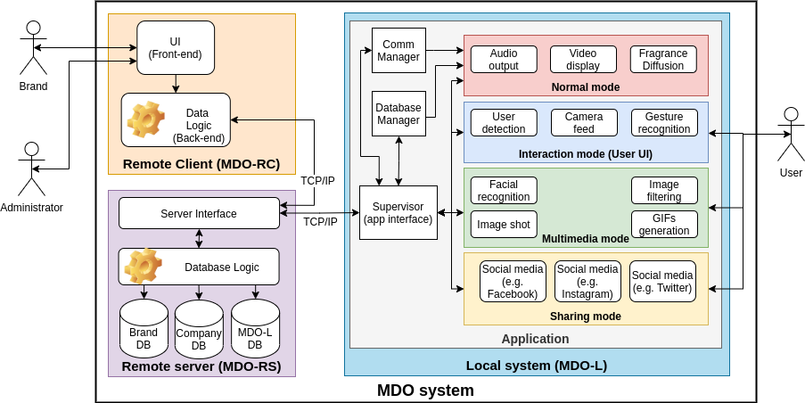
System Overview

Slide 13
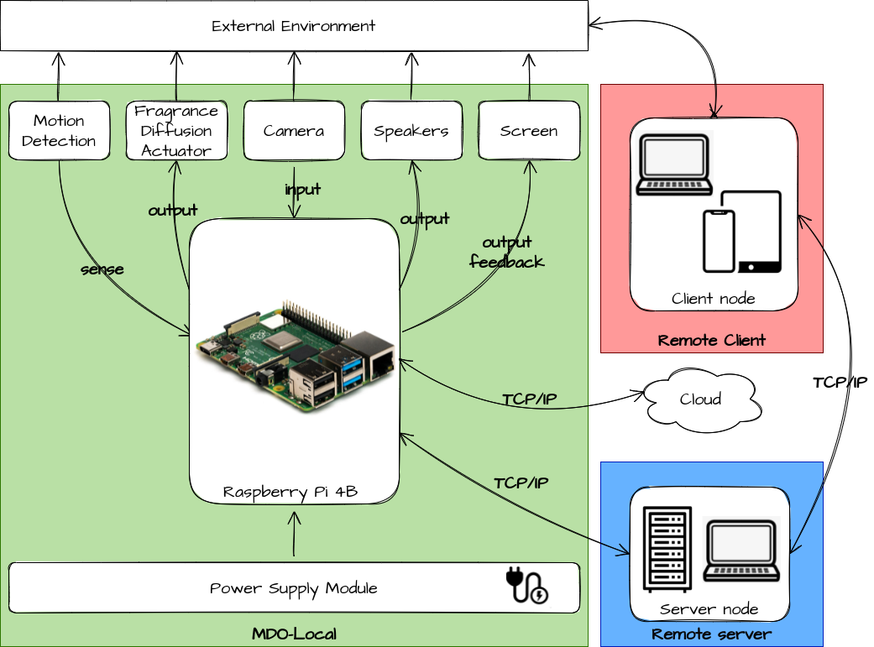
System Architecture
HW Architecture

Slide 14
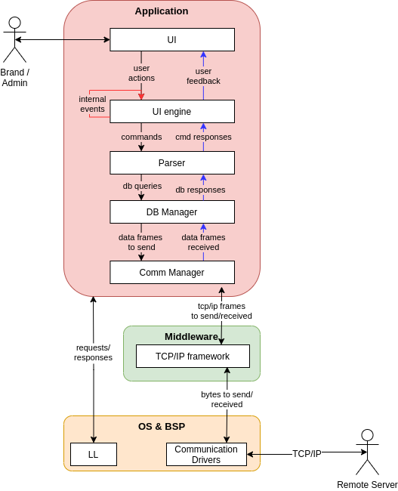
System Architecture
SW Architecture:
Remote Client

Slide 15
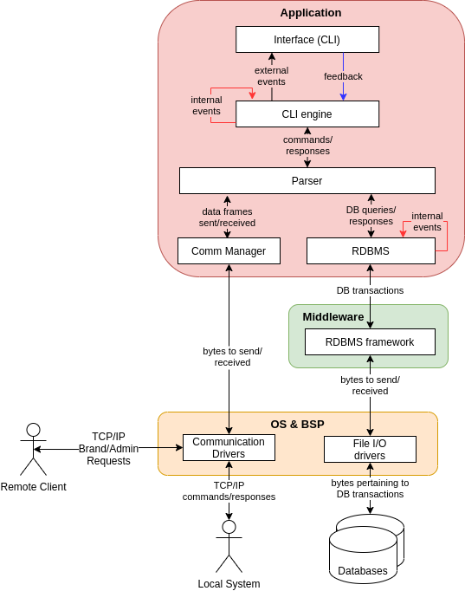
System Architecture
SW Architecture:
Remote Server

Slide 16
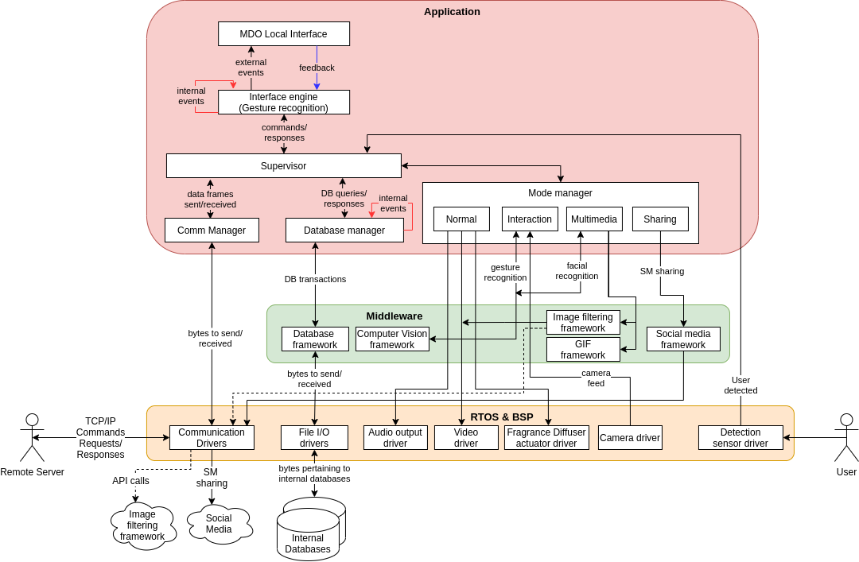
System Architecture
SW Architecture: Local System

Slide 17
Subsystem Decomposition
For each subsystem {RC, RS, LS} do:
User mockups
Events
Use case diagram
Dynamic operation (state-machine diagram)
Flow of events (sequence diagram)

Slide 18
Remote Client

Slide 19
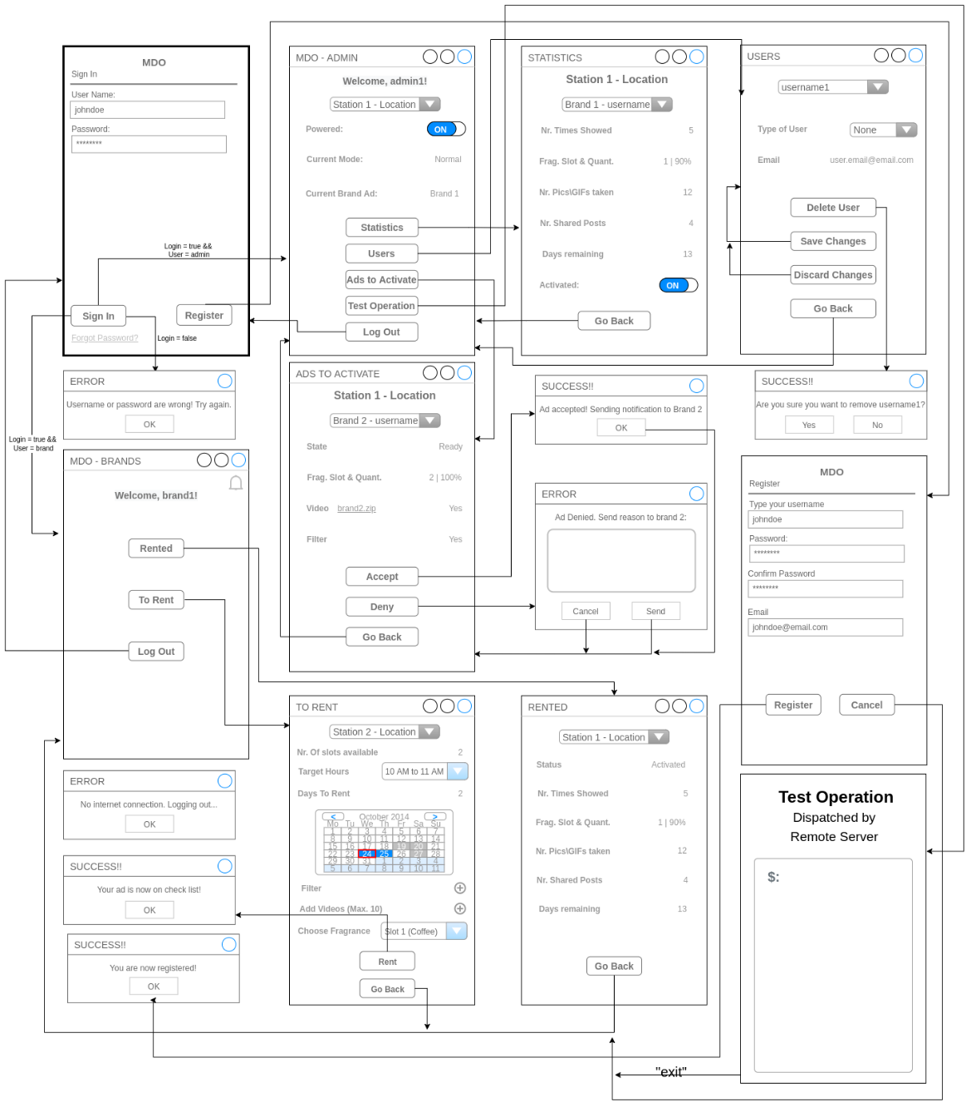
Subsystem Decomposition
MDO-RC: User Mock-ups

Slide 20
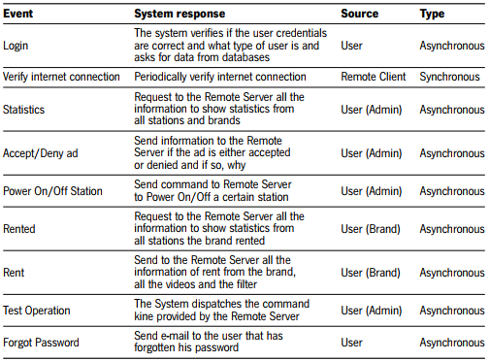
Subsystem Decomposition
MDO-RC: Events

Slide 21
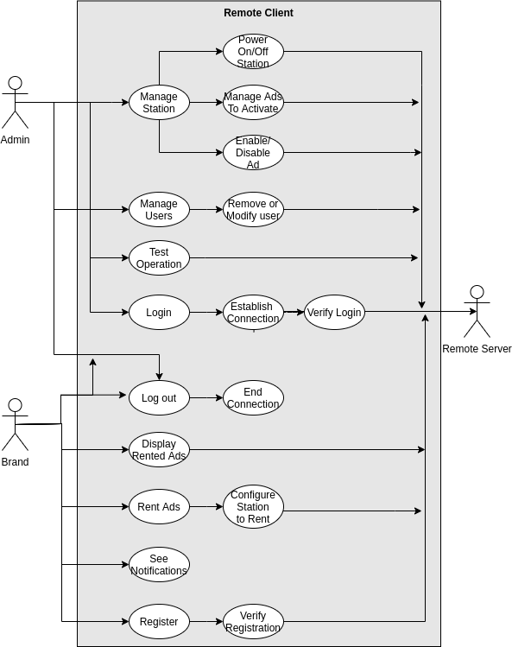
Subsystem Decomposition
MDO-RC: Use cases

Slide 22
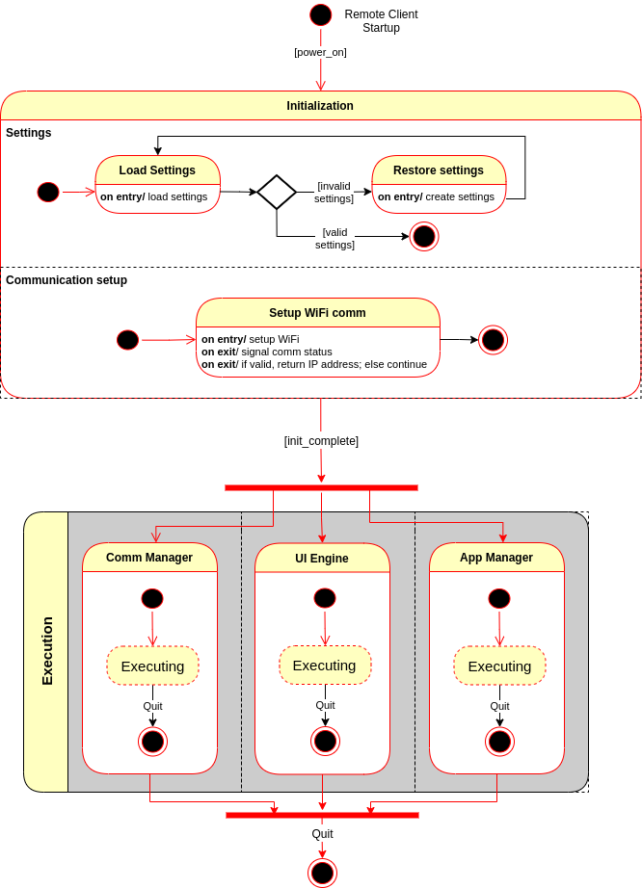
Subsystem Decomposition
MDO-RC: State-mach: main

Slide 23
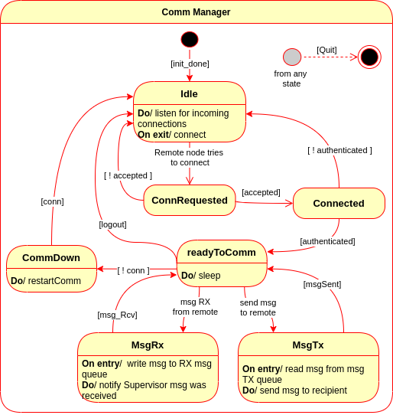
Subsystem Decomposition
MDO-RC: State-mach: Comm

Slide 24
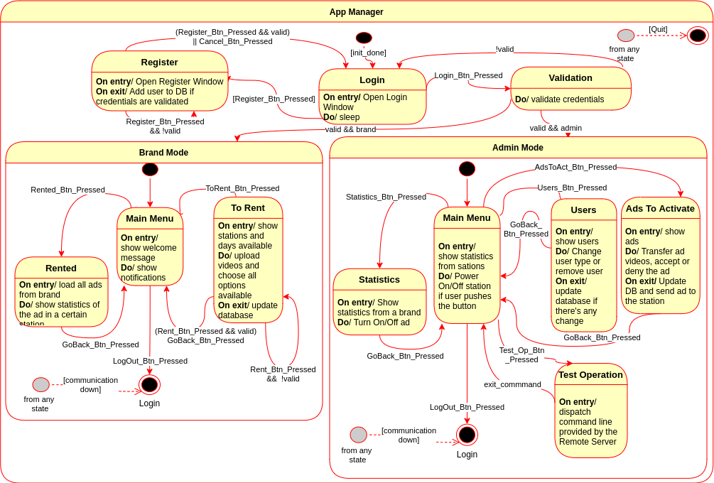
Subsystem Decomposition
MDO-RC: State-mach: App Manager

Slide 25
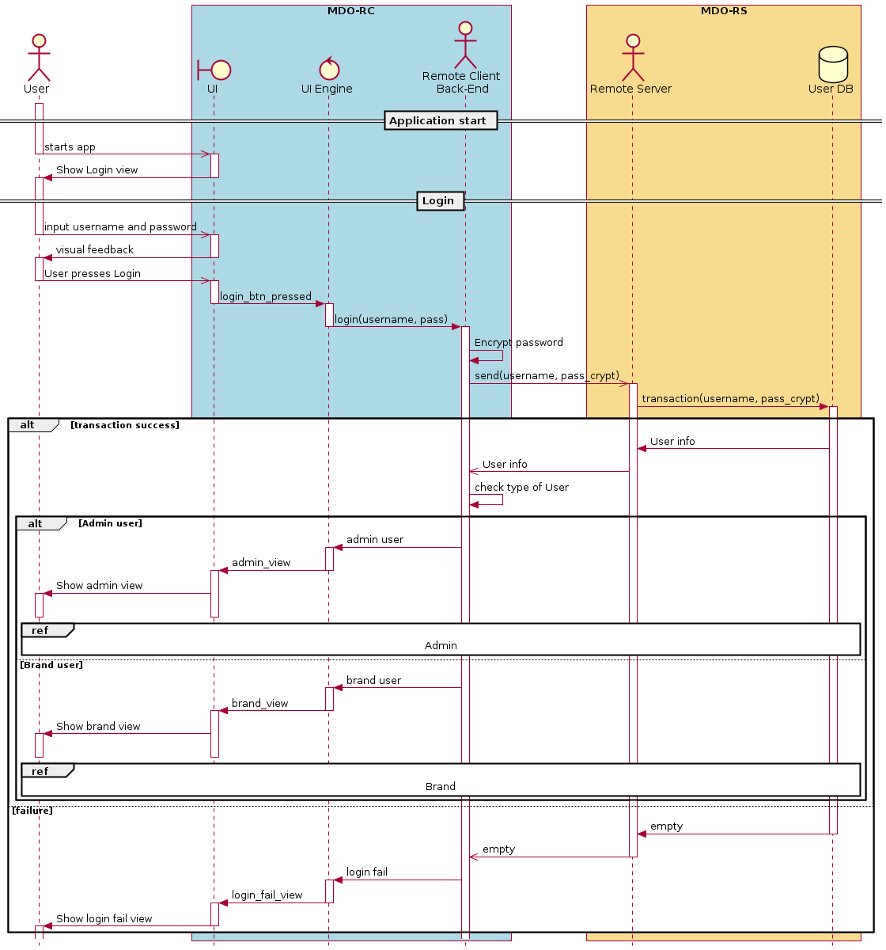
Subsystem Decomposition
MDO-RC: Seq-diag: Login

Slide 26
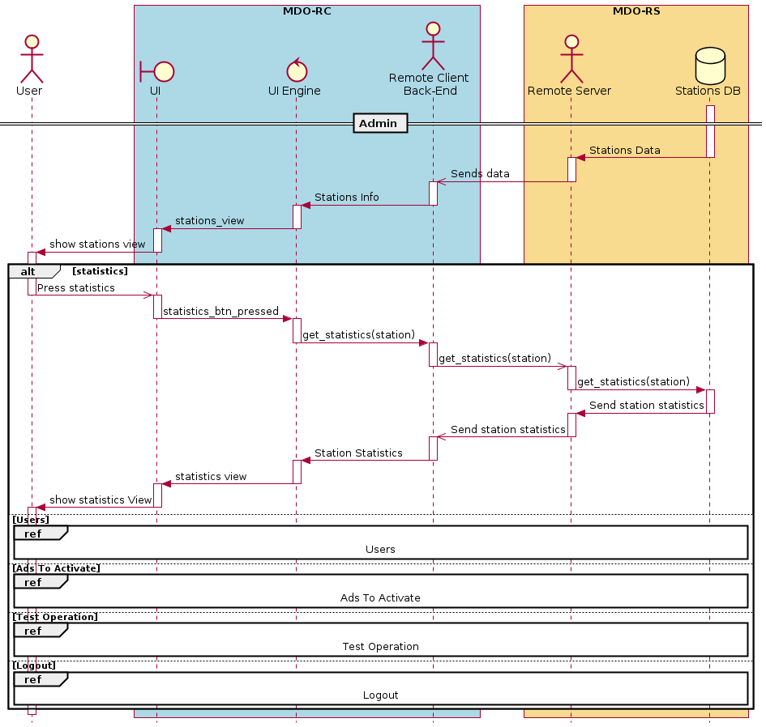
Subsystem Decomposition
MDO-RC: Seq-diag: Admin statistics

Slide 27
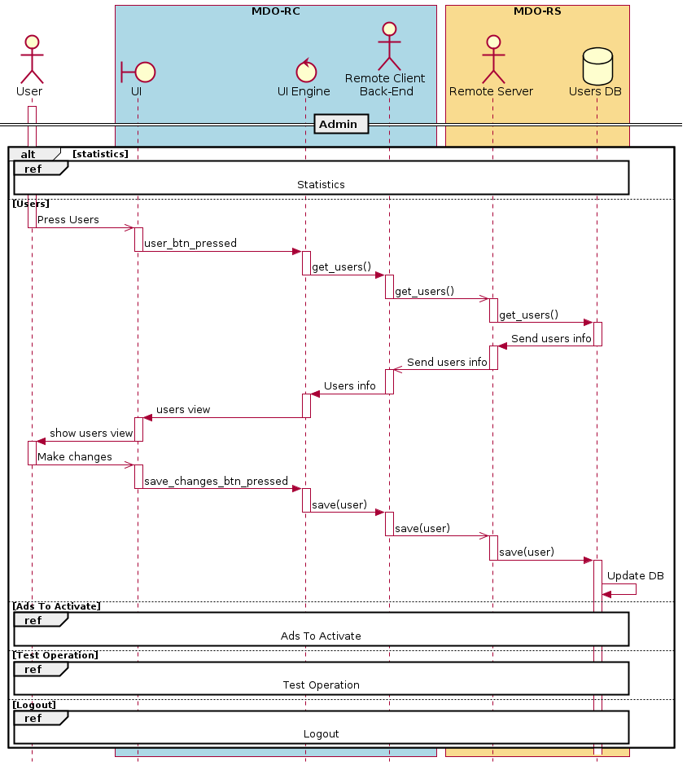
Subsystem Decomposition
MDO-RC: Seq-diag: Admin users

Slide 28
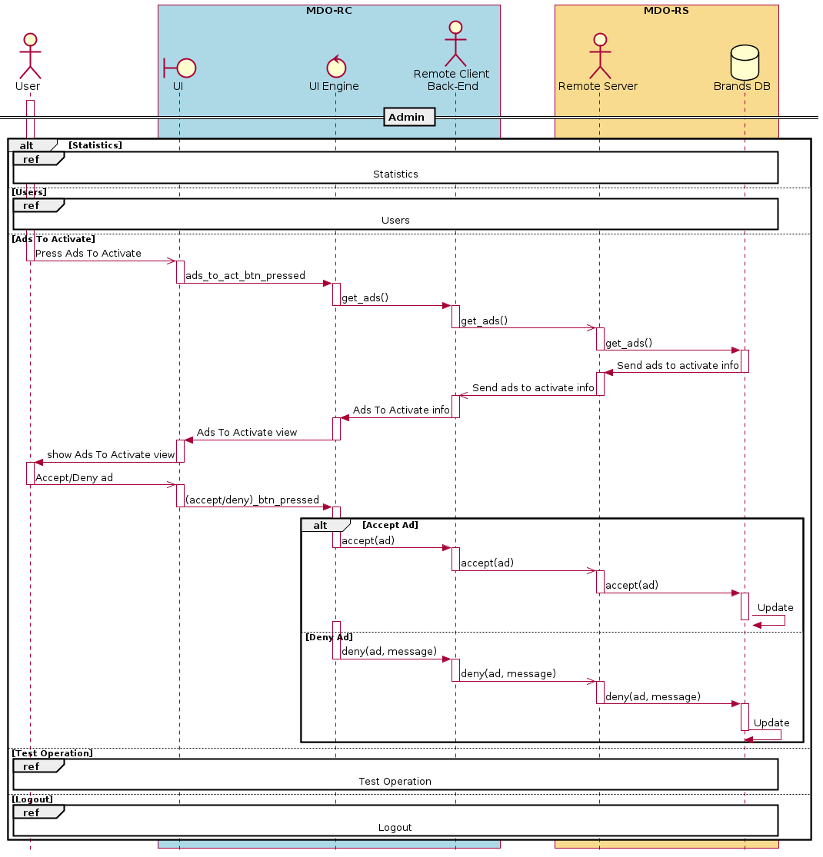
Subsystem Decomposition
MDO-RC: Seq-diag: Admin ads to
activate

Slide 29
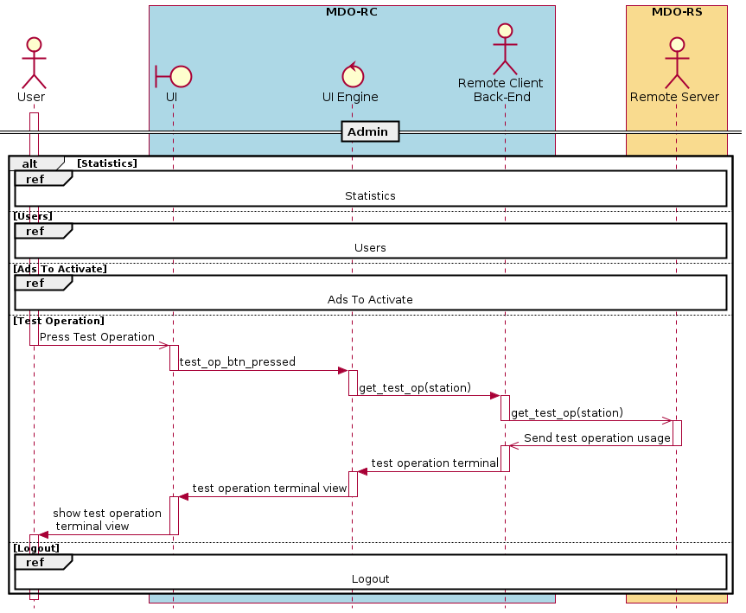
Subsystem Decomposition
MDO-RC: Seq-diag: Admin test
operation

Slide 30
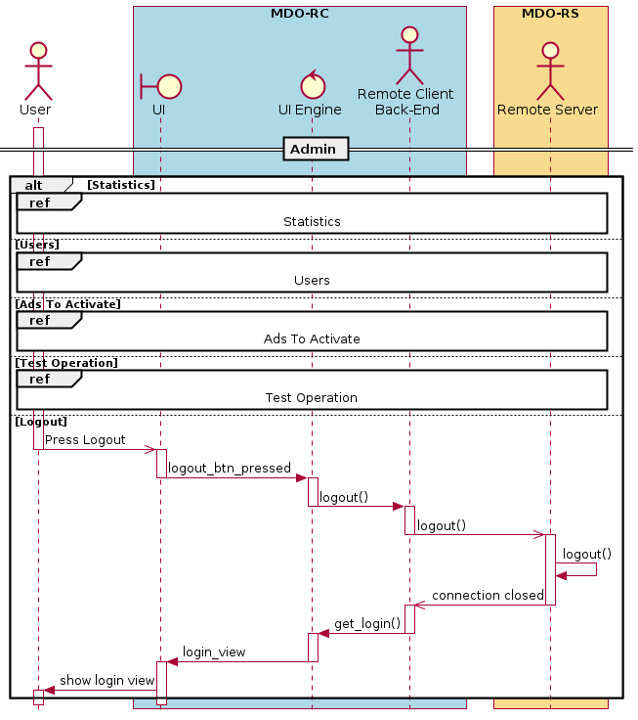
Subsystem Decomposition
MDO-RC: Seq-diag: Admin logout

Slide 31
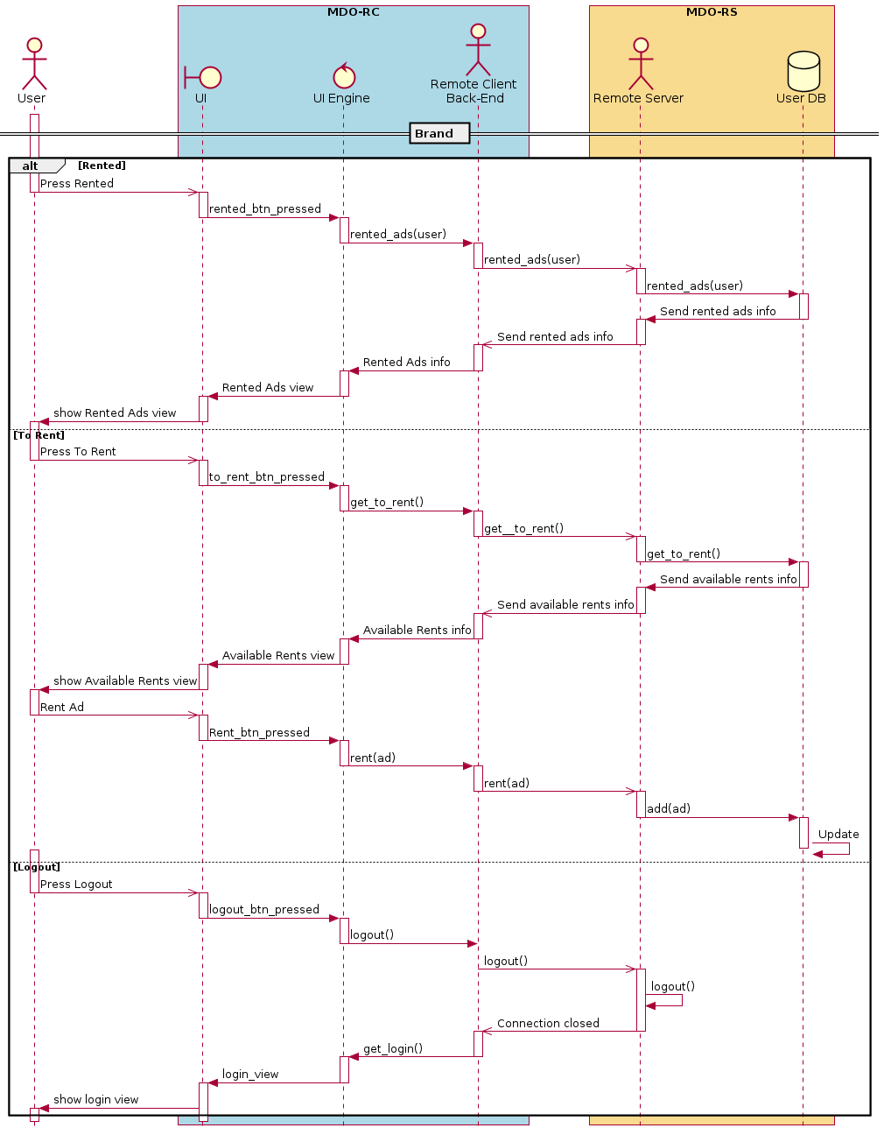
Subsystem Decomposition
MDO-RC: Seq-diag: Brand

Slide 32
Remote Server

Slide 33
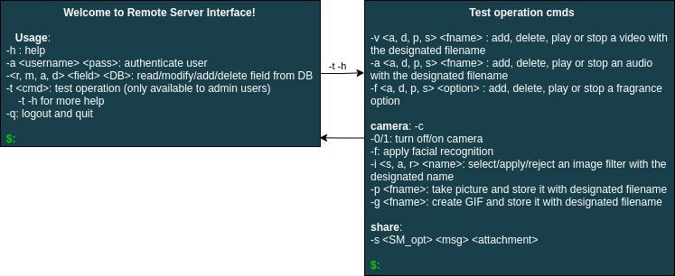
Subsystem Decomposition
MDO-RS: User Mock-ups - CLI

Slide 34
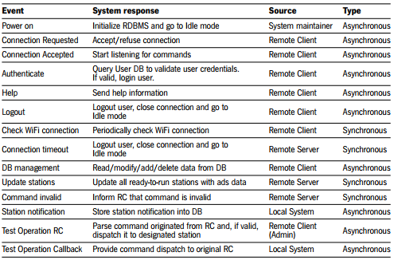
Subsystem Decomposition
MDO-RS: Events

Slide 35
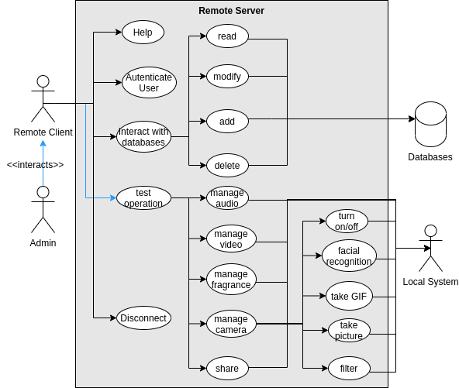
Subsystem Decomposition
MDO-RS: Use cases

Slide 36
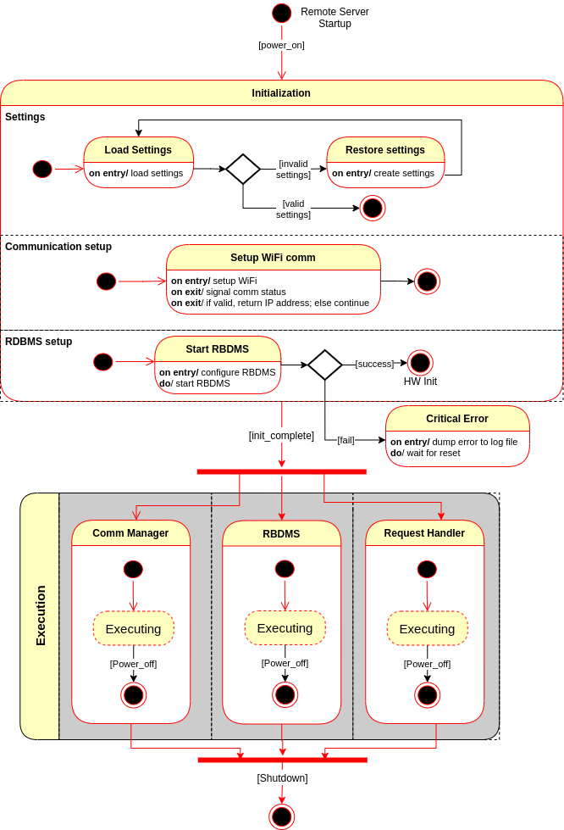
Subsystem Decomposition
MDO-RS: State-mach: main

Slide 37
Subsystem Decomposition
MDO-RS: State-mach: Comm

Slide 38
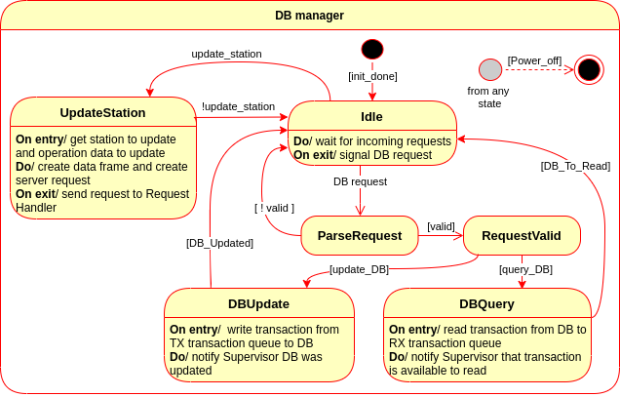
Subsystem Decomposition
MDO-RS: State-mach: DB manager

Slide 39
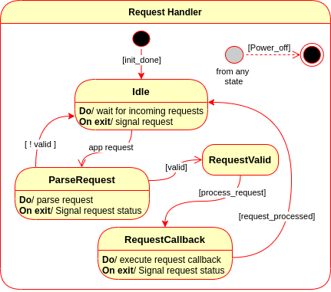
Subsystem Decomposition
MDO-RS: State-mach: Request Handler

Slide 40
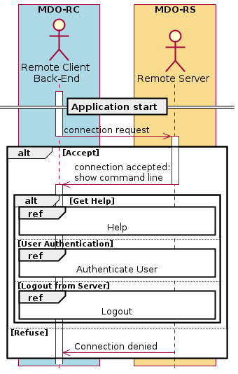
Subsystem Decomposition
MDO-RS: Seq-diag: Main

Slide 41
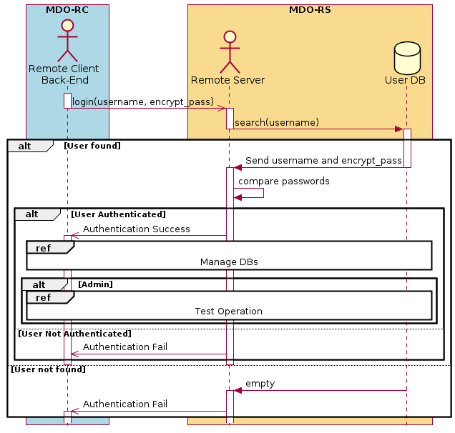
Subsystem Decomposition
MDO-RS: Seq-diag:
Authenticate

Slide 42
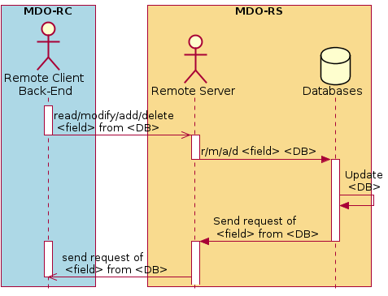
Subsystem Decomposition
MDO-RS: Seq-diag:
Manage DBS

Slide 43
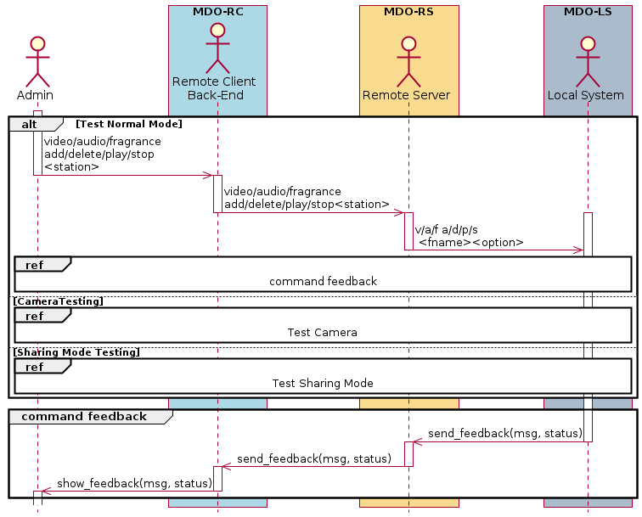
Subsystem Decomposition
MDO-RS: Seq-diag: Test operation – Normal mode

Slide 44
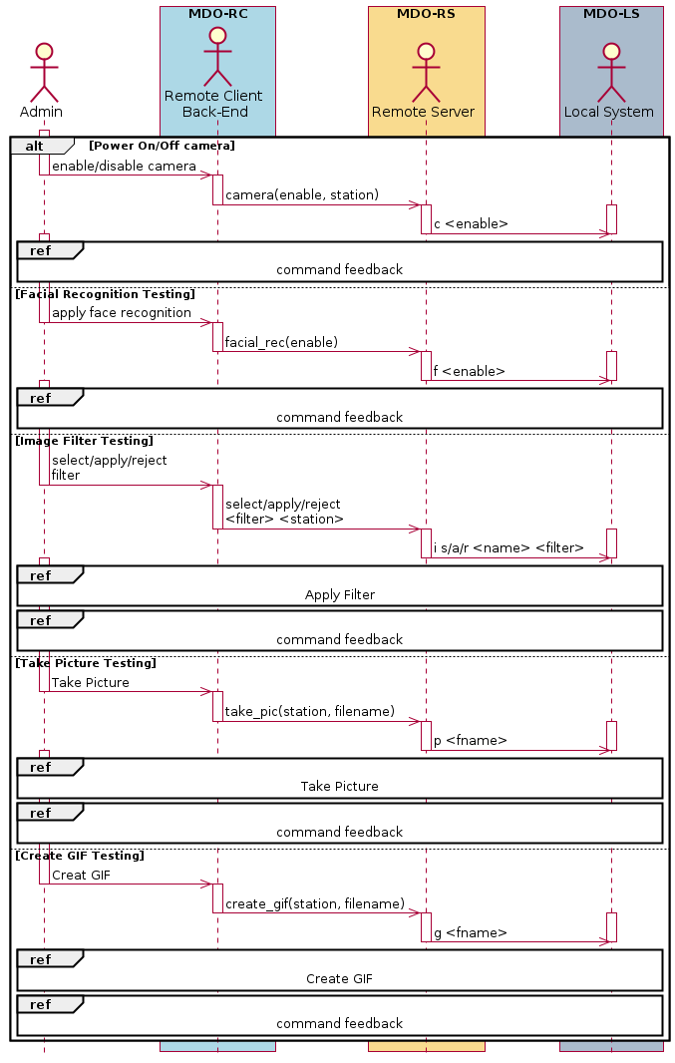
Subsystem Decomposition
MDO-RS: Seq-diag: Test operation - Camera

Slide 45
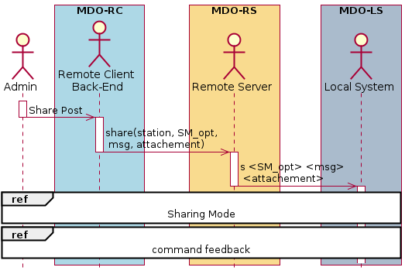
Subsystem Decomposition
MDO-RS: Seq-diag: Test operation – Sharing mode

Slide 46
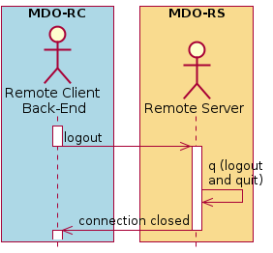
Subsystem Decomposition
MDO-RS: Seq-diag: Logout

Slide 47
Local System

Slide 48
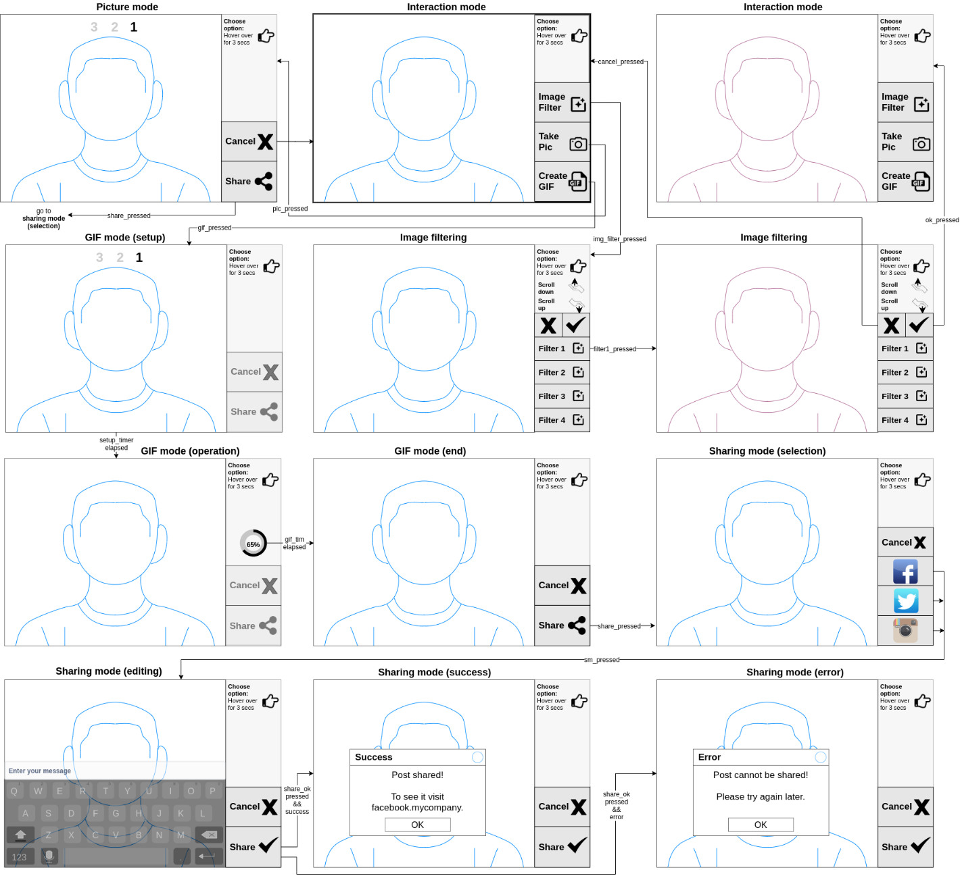
Subsystem Decomposition
MDO-L: User Mock-ups

Slide 49
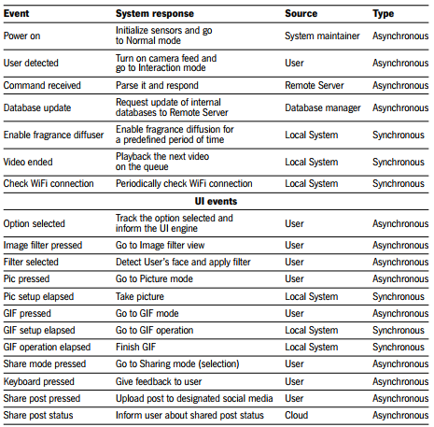
Subsystem Decomposition
MDO-L: Events

Slide 50
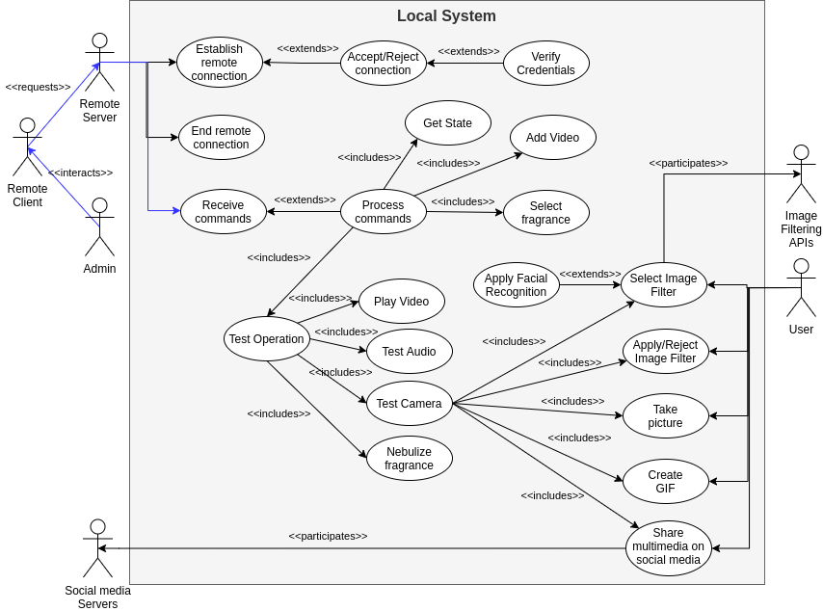
Subsystem Decomposition
MDO-L: Use cases

Slide 51
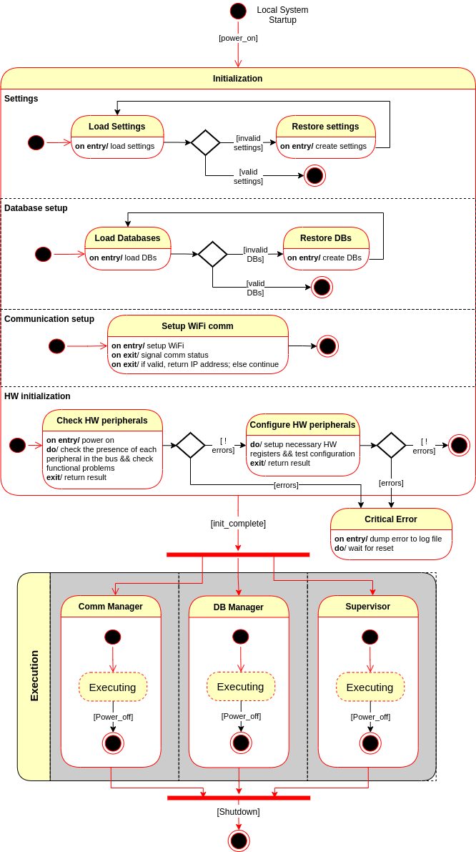
Subsystem Decomposition
MDO-L: State-mach: main

Slide 52
Subsystem Decomposition
MDO-L: State-mach: Comm

Slide 53
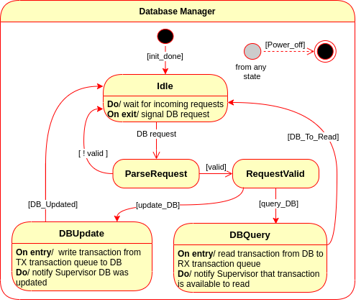
Subsystem Decomposition
MDO-L: State-mach: DB manager

Slide 54
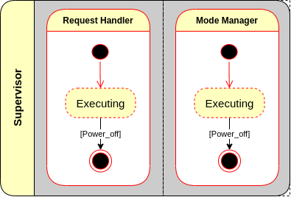
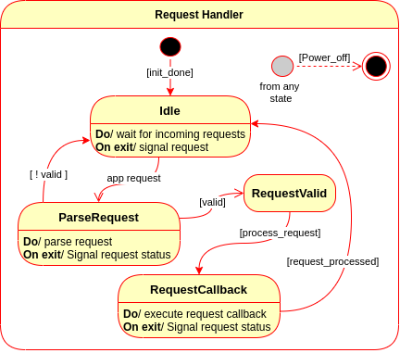
Subsystem Decomposition
MDO-L: State-mach: Supervisor

Slide 55
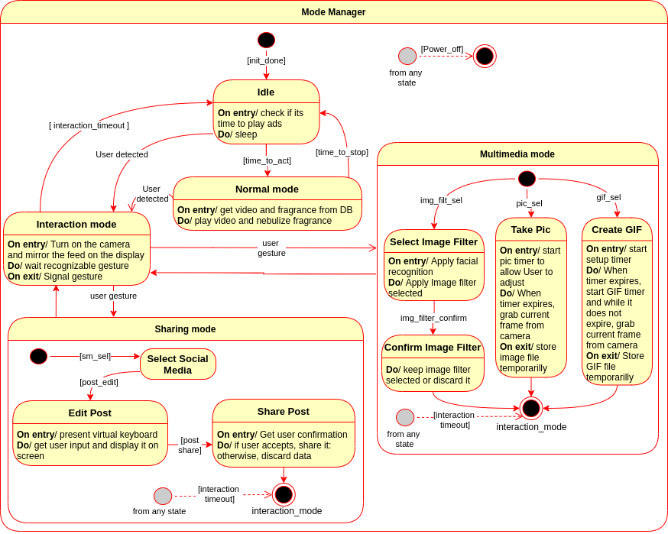
Subsystem Decomposition
MDO-L: State-mach: Supervisor – Mode manager

Slide 56
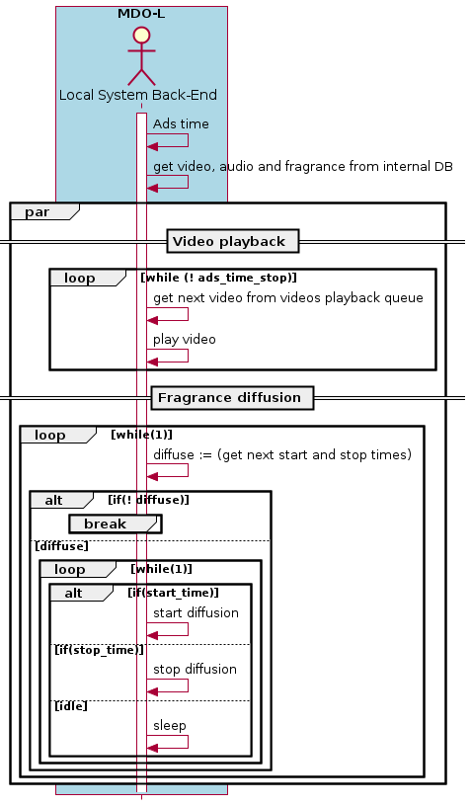
Subsystem Decomposition
MDO-L: Seq-diag: Normal mode

Slide 57
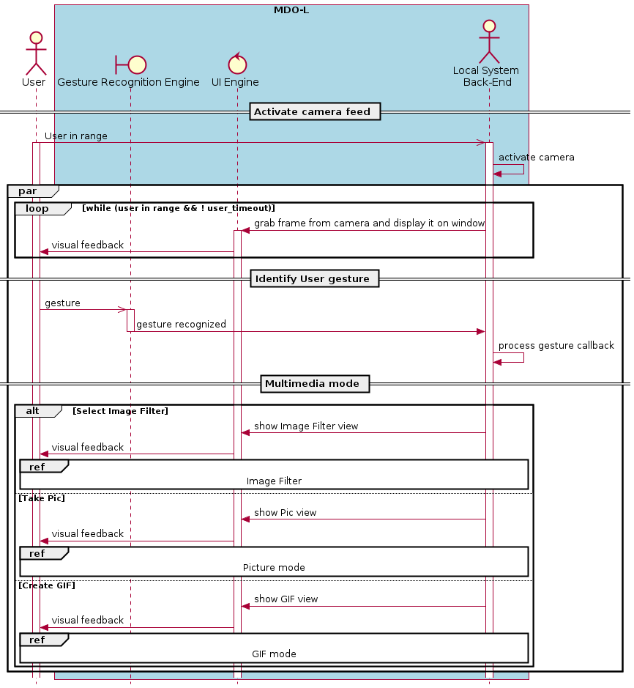
Subsystem Decomposition
MDO-L: Seq-diag: Interaction mode

Slide 58
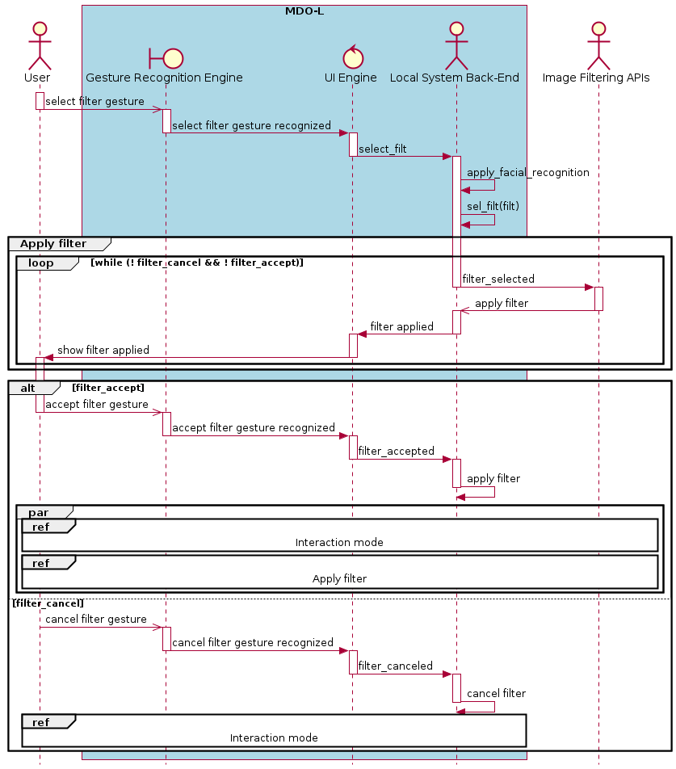
Subsystem Decomposition
MDO-L: Seq-diag: Multimedia mode Select image filter

Slide 59
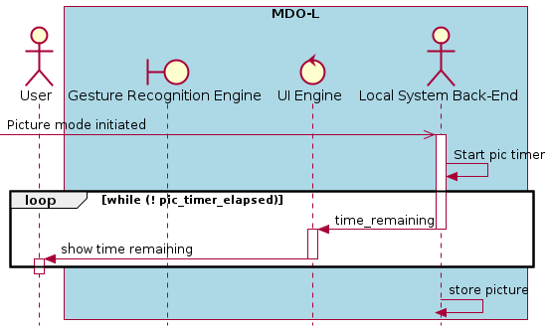
Subsystem Decomposition
MDO-L: Seq-diag: Multimedia mode - Take picture

Slide 60
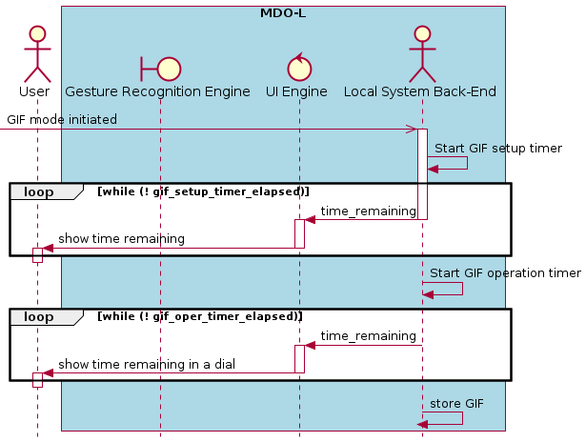
Subsystem Decomposition
MDO-L: Seq-diag: Multimedia mode – Create GIF

Slide 61
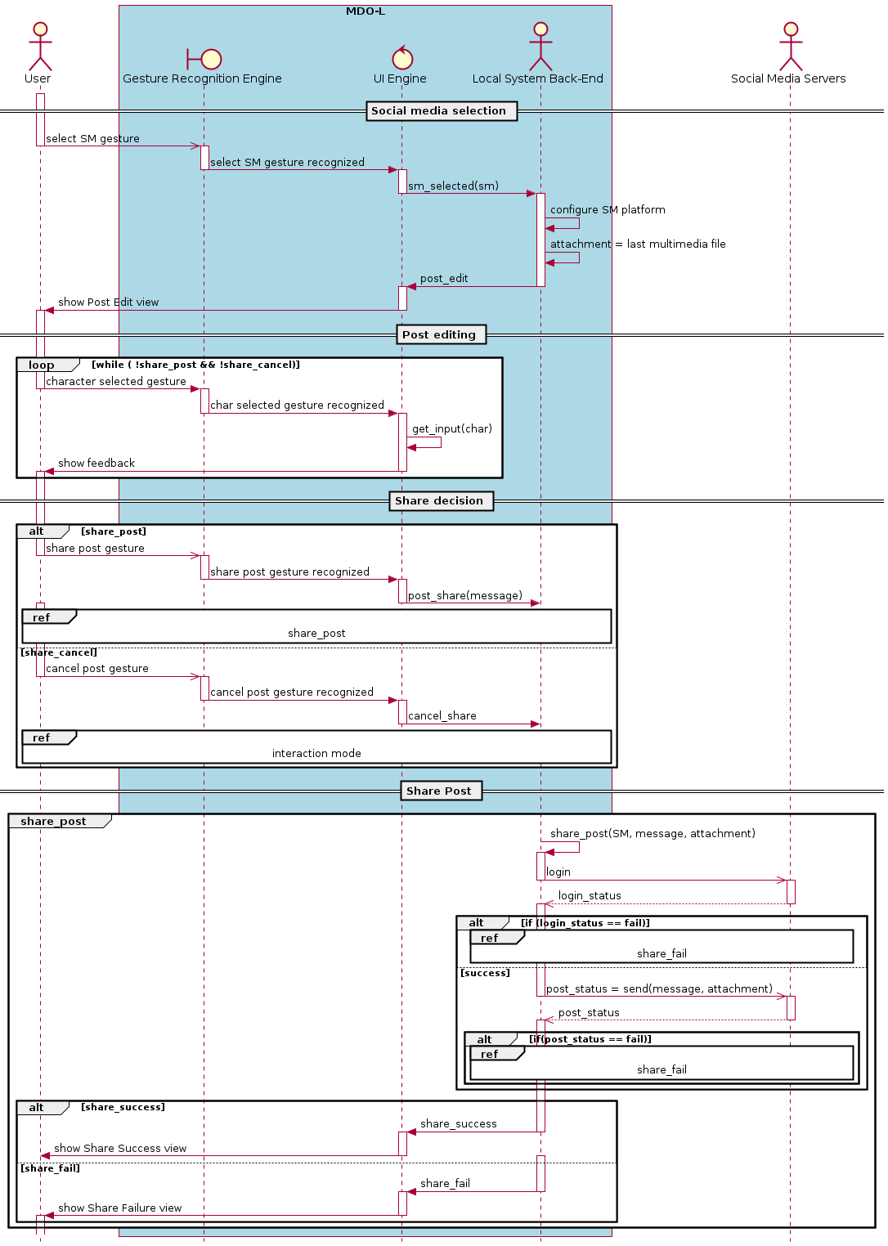
Subsystem Decomposition
MDO-L: Seq-diag: Sharing mode

Slide 62
Subsystem Decomposition
MDO-L: Seq-diag: Sharing mode (cont.)

Slide 63
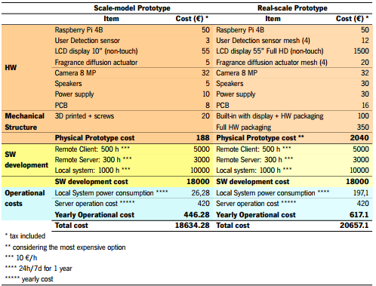
Budget estimation

Slide 64
Bibliography
[1] Fei Tao, Meng Zhang, and A.Y.C. Nee. Chapter 12 - digital twin, cyber–physical system, and internet of things. In Fei Tao, Meng Zhang, and A.Y.C. Nee, editors, Digital Twin Driven Smart Manufacturing, pages 243–256. Academic Press, 2019. ISBN 978-0-12-817630-6. doi: https: //doi.org/10.1016/B978-0-12-817630-6.00012-6. URL https://www.sciencedirect.com/science/ article/pii/B9780128176306000126. [2] What the nose knows. URL https://news.harvard.edu/gazette/story/2020/02/how-scent-emotion-and-memory-are-intertwined-and-exploited/. accessed: 2021-10-23. [3] Martin Lindstrom. Brand sense: How to build powerful brands through touch, taste, smell, sight and sound. Strategic Direction, 2006. [4] Digital outdoor advertising: The what, the why, the how. URL https://bubbleoutdoor.com/ digital-outdoor-advertising-what-why-how/. accessed: 2021-10-24. [5] Digital outdoor market to be worth $55 BN in 5 years. URL https://www.decisionmarketing.co.uk/news/digital-outdoor-market-to-be-worth-55bn-in-5-years. accessed: 2021-10-24. [6] Scent marketing; type of sensory marketing targeted at the olfactory sense, . URL https://www.air-aroma.com/scent-marketing/. accessed: 2021-10-24. [7] Scent basics: What is scent marketing, scent branding and ambient scent, . URL https:// reedpacificmedia.com/scent-basics-what-is-scent-marketing-scent-branding-and-ambient-scent/. accessed: 2021-10-24. [8] Digital scent technology market with covid-19 impact analysis, . URL https://www. marketsandmarkets.com/Market-Reports/digital-scent-technology-market-118670062.html. ac- cessed: 2021-10-24

